Slide 1
BANK LOAN CASE STUDY

Slide 2
Objective
The primary objective of this Exploratory Data Analysis (EDA) project is to identify patterns and key factors that indicate whether a customer is likely to have difficulty paying their loan installments. By analyzing customer and loan attributes, I aim to support better decision-making in the loan approval process, balancing business growth and financial risk.

Slide 3
Tech-Stack
Approach
Data Understanding
Data
Pre Processing
Data Analysis
Data Visualization
Insights
Microsoft Excel

Slide 4
Data Understanding
Application Data
After Processing
Rows
50,000
Columns
122
Rows
50,000
Columns
47

Slide 5
Irrelevant columns to drop
FLAG_DOCUMENT_2 | FLAG_DOCUMENT_12 | FLAG_MOBIL
FLAG_DOCUMENT_3 | FLAG_DOCUMENT_13 | FLAG_EMP_PHONE
FLAG_DOCUMENT_4 | FLAG_DOCUMENT_14 | FLAG_WORK_PHONE
FLAG_DOCUMENT_5 | FLAG_DOCUMENT_15 | FLAG_CONT_MOBILE
FLAG_DOCUMENT_6 | FLAG_DOCUMENT_16 | FLAG_PHONE
FLAG_DOCUMENT_7 | FLAG_DOCUMENT_17 | FLAG_EMAIL
FLAG_DOCUMENT_8 | FLAG_DOCUMENT_18
FLAG_DOCUMENT_9 | FLAG_DOCUMENT_19
FLAG_DOCUMENT_10 | FLAG_DOCUMENT_20
FLAG_DOCUMENT_11 | FLAG_DOCUMENT_21

Slide 6
Previous Application Data
After Processing
Rows
50,000
Columns
37
Rows
50,000
Columns
22

Slide 7
Irrelevant columns to drop
NFLAG_LAST_APPL_IN_DAY
FLAG_LAST_APPL_PER_CONTRACT
HOUR_APPR_PROCESS_START
WEEKDAY_APPR_PROCESS_START

Slide 8
Application Data and Previous Application Data
Filling Null Values
Imputed columns containing
Non-categorical data using median value.
Categorical data using mode value.
Merged the cleaned files for further analysis using innerjoin
Removed the duplicate rows

Slide 9

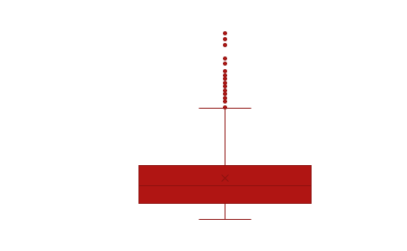

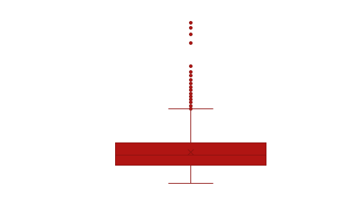
Outliers
Insights
Loans for more expensive goods may have a higher default risk, especially if the borrower's income or creditworthiness is not proportionate to the loan amount.
High annuity amounts can indicate larger loan amounts or shorter loan terms. For borrowers, higher annuities can stress their financial capacity, increasing the likelihood of default if their income is not sufficiently high.

Slide 10
Data Imbalance
The chart reveals that non-defaulters vastly outnumber defaulters. This indicates an imbalanced dataset where the majority class (non-defaulters) dominates the minority class (defaulters).

Slide 11
Univariate/Segmented Univariate Analysis
Higher Default Rate for Cash Loans:. Indicates higher risk associated with cash loans, which might be due to larger loan amounts, less stringent approval criteria, or other factors.
Default Rate Significance: Even though the overall number of revolving loans is lower, the default rate is also a critical factor. The lower default rate for revolving loans might suggest that these loans are given to more creditworthy individuals or have more manageable repayment terms.

Slide 12
Univariate/Segmented Univariate Analysis
The higher number of female borrowers could indicate a higher demand or approval rate for loans among women.
This distribution could be influenced by various socio-economic factors, cultural norms, or specific loan
Higher Default Rate for Males: The default rate for male borrowers is significantly higher than for female borrowers. This suggests that male borrowers may pose a higher risk of defaulting on loans compared to female borrowers.
Loan Approval Strategy: Banks and financial institutions might need to consider gender-specific strategies for loan approvals and risk assessment. This could involve stricter credit evaluations for male applicants or targeted financial education programs.

Slide 13
Bivariate Analysis
Unemployed Borrowers: Both non-defaulters and defaulters in the unemployed category have the highest average credit amount compared to other income types, with non-defaulters having a higher average
Despite having a high average credit amount, the unemployed category shows a significant drop in average credit amount for defaulters. This indicates a higher risk associated with lending to unemployed individuals, possibly due to their unstable income.

Slide 14
Correlation For Target 0
The strongest relationship observed is between the amount of credit and goods price (0.987). This implies that almost all credit amounts are directly tied to the value of the goods being financed.
The strong correlation between credit amount and annuity (0.771), and between annuity and goods price (0.776), indicates that these financial aspects are closely linked.
Moderate Relationships: Total income has moderate correlations with credit amount, annuity amount, and goods price, suggesting that income plays a significant role in determining these financial variables, but not as strongly as the credit amount and goods price relationship.
Weak Relationships:The number of children has very weak correlations with all other variables, indicating that family size does not have a significant impact on the financial variables considered in this dataset.
 | CNT_CHILDREN | AMT_INCOME_TOTAL | AMT_CREDIT | AMT_ANNUITY | AMT_GOODS_PRICE
CNT_CHILDREN | 1
AMT_INCOME_TOTAL | 0.036319722 | 1
AMT_CREDIT | 0.005705458 | 0.377965752 | 1
AMT_ANNUITY | 0.02638396 | 0.451135167 | 0.770772818 | 1
AMT_GOODS_PRICE | 0.001518097 | 0.384575912 | 0.986999774 | 0.775835204 | 1

Slide 15
Correlation For Target 1
Strong Relationships: The strongest relationship is between the amount of credit and the goods price (0.9823). This indicates that the amount of credit taken is almost directly proportional to the value of the goods being financed.
There is also a strong correlation between the credit amount and annuity amount (0.7497), and between the annuity amount and goods price (0.7495). This suggests a significant interdependence between these financial variables.
Weak Relationships: The correlations between the number of children and all other variables are extremely weak, indicating that the number of children does not have a substantial impact on financial metrics.
Similarly, total income shows very weak correlations with other variables, suggesting that it does not significantly influence credit amount, annuity amount, or goods price.
 | CNT_CHILDREN | AMT_INCOME_TOTAL | AMT_CREDIT | AMT_ANNUITY | AMT_GOODS_PRICE
CNT_CHILDREN | 1
AMT_INCOME_TOTAL | 0.01011 | 1
AMT_CREDIT | 0.007602 | 0.015271 | 1
AMT_ANNUITY | 0.029173 | 0.018005 | 0.749665 | 1
AMT_GOODS_PRICE | -0.00108 | 0.01327 | 0.982268 | 0.749504 | 1

Slide 16
Thank You

